Slide 1


SmartHire
Venture Viability Analysis
Sri Sairam Engineering College,Chennai

Slide 2

SmartHire
We build AI tools that automate resume screening and rank candidates to help HR hire faster.
Sri Sairam Engineering College,Chennai

Slide 3
Context
Recruiters spend 23 hours per hire; 67% say AI improves hiring efficiency and reduces bias.
3

Slide 4

Problem Statement
Problem
Manual resume screening causes delays, bias, and inefficiency, hurting job seekers, recruiters, companies, and fair hiring.
Impact
Delayed hiring, biased decisions, recruiter overload, poor hires, and inequality impact candidates, HR teams, companies, and society.
4

Slide 5

Problem Statement/Industry
Problem Being Solved
Manual resume screening causes delays, bias, and inefficiency in recruitment. HR professionals spend 23 hours per hire on repetitive tasks, leading to recruiter burnout, missed talent, and unfair candidate evaluation. This affects job seekers' opportunities, slows organizational hiring, and perpetuates workplace inequality.
Supporting Data
Recruiters spend 23 hours per hire; 67% say AI improves hiring efficiency and reduces bias.
Source: LinkedIn Talent Trends 2023, Glassdoor 2022, IEEE AI Recruitment Study 2021.
Area
Business Services
Industry
Professional & Business Services
Domain
Human Resource

Slide 6



Problem Analysis
Affected Stakeholders
Job seekers face delays and bias in hiring decisions.
Recruiters spend excessive
time manual screening resumes, risking errors and burnout.
Organizations suffer from slow hiring and poor talent matches. Hiring managers get biased
candidate lists. Society loses from unequal employment opportunities.
Impact on Stakeholders
Job seekers face missed opportunities and frustration. Recruiters experience overload and bias. Companies deal with longer vacancy periods, lower hire quality, and diversity loss. Hiring managers face reduced confidence in selections.
Society endures slowed economic growth and persistent inequality.
Root Causes
Manual screening processes are slow and unscalable. Recruiters face fatigue and subjective judgments cause bias. Lack of automation and standardized evaluation lets inefficiencies and unfairness persist.
Technology gaps and resistance to change also slow recruitment progress.
Personal/Team Connect
Our team is passionate about leveraging AI to solve real-world problems like biased recruitment. We aim to reduce hiring inefficiencies and promote fairness, aligning with our skills in AI, NLP, and software development. We believe equitable talent hiring can boost organizations and society.

Slide 7

Target Customer Segments
Primary
Recruiters and HR managers in mid to large companies facing hiring inefficiencies and bias.
Secondary
Small & medium-sized enterprises seeking to improve their recruitment process efficiency.
5

Slide 8

Customer Segment & Persona
Primary Segment
Recruiters and HR managers in mid to large companies facing hiring inefficiencies and bias.
Persona
Secondary Segment
Small & medium-sized enterprises seeking to improve their recruitment process efficiency.
John Doe
Age in years: 30 Location: Suburban
Organizational Role: HR Manager
(if applicable)

Slide 9
Customer Profile
Education: College pass out
Gender: Male
Occupation: Works for a private company
Interests/Hobbies: Travel
Primary Source of Information: News Apps
Shopping Preference: Hybrid Comfort with Technology: High Favourite Social Media: Youtube
Favourite Offline Gathering Spots: Conferences

Slide 10

Jobs-to-be-Done
Functional JTBD
Quickly source qualified candidates, screen resumes efficiently, schedule interviews, coordinate with hiring managers, track applicants, reduce time-to-hire, maintain candidate pipelines, ensure fair evaluation, and manage multiple open roles without losing strong candidates.
Emotional JTBD
Feel confident that the best candidates are being identified, reduce stress from high hiring pressure, avoid fear of making bad hires, feel in control of hiring pipelines, experience less burnout from repetitive screening tasks, and feel proud of building strong teams.
Social JTBD
Be seen as a strategic partner by leadership, earn trust from hiring managers, gain recognition for fast and quality hiring, maintain a strong employer brand with candidates, and demonstrate professionalism and efficiency to executives and colleagues.

Slide 11


Current Alternatives
Current Alternatives
Use ATS platforms, LinkedIn sourcing, manual resume screening, recruitment agencies, job boards, spreadsheets, email coordination, interview scheduling tools, referral programs, and recruiter teams to manage candidate pipelines and hiring processes.
Gaps in Current Alternatives
Manual resume screening is time-consuming, ATS filters miss strong candidates, tools are fragmented across platforms, scheduling and communication require heavy coordination, hiring managers delay feedback, and recruiters struggle with high candidate volume and pressure to hire faster.

Slide 12
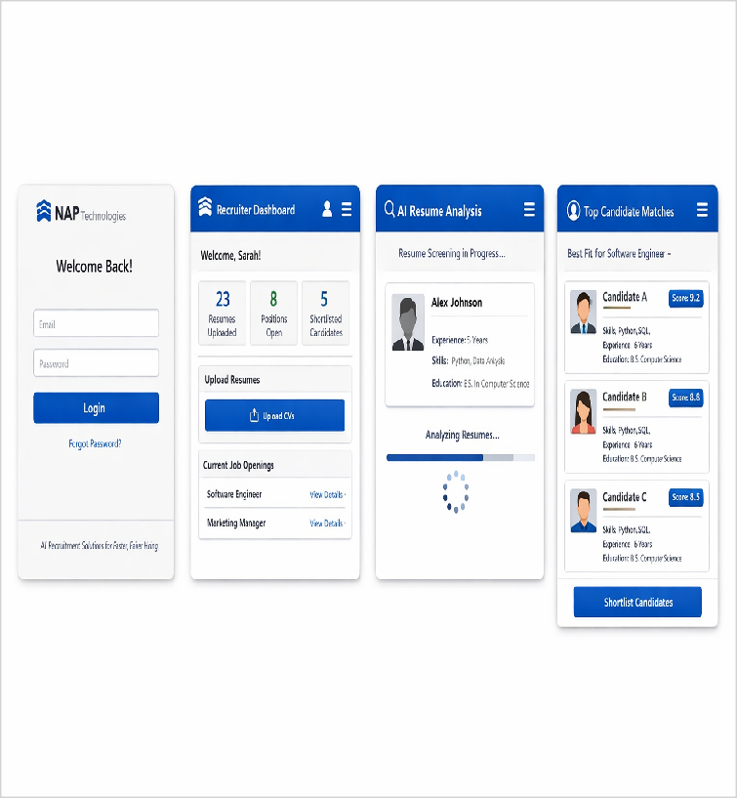
Our Solution
Solution
AI-powered recruitment software that automates resume validation and filtration using natural language processing. It prioritizes applicants based on their skills, experience, and job fit.
Core Technologies/ Methodologies
NLP, ML ranking models, resume parsing, cloud APIs, React frontend, Python backend, PostgreSQL DB.
6

Slide 13

Solution Design
Our Solution
AI-powered recruitment software that automates resume validation and filtration using natural language processing. It prioritizes applicants based on their skills, experience, and job fit.
Key Features
AI resume parsing, automated candidate ranking, skill-based job matching, bias-reduced screening, ATS integration, interview shortlist generation, recruiter dashboards, and analytics to track hiring.
Uniqueness
Proprietary AI model that evaluates skills and experience contextually, reduces hiring bias, ranks candidates by job fit, integrates with ATS tools, and continuously improves from recruiter feedback.
Solution Format:
AI-powered recruitment SaaS platform for HR teams
Core Technologies/ Methodologies:
NLP, ML ranking models, resume parsing, cloud APIs, React frontend, Python backend, PostgreSQL DB.

Slide 14

Solution Benefits
Functional Benefits
Reduces screening time by 90%, eliminates hiring bias, improves candidate quality with 97% accuracy, automates interview scheduling, integrates with existing ATS, provides predictive analytics
Emotional Benefits
Confidence in data-driven hiring decisions, reduced stress from tight deadlines, satisfaction from finding right talent efficiently, peace of mind with unbiased screening, relief from manual workload
Social Benefits
Recognition as modern tech-savvy HR professional, enhanced reputation for innovation, trust from management, admiration for improving efficiency, strengthened collaboration with team leaders
Macro Benefits
Promotes equal employment opportunity by eliminating hiring bias. Boosts economic productivity through faster, better talent matching.
Reduces paper waste by digitizing recruitment processes.

Slide 15


Competitors
Direct
Workable, iSmartRecruit, Zoho Recruit
Greenhouse, Paradox (Olivia AI), Workday, Eightfold AI, HireVue
Indirect
Traditional Applicant Tracking Systems (ATS) without AI,Manual recruitment agencies,Basic job portal
SAP SuccessFactors, Oracle HCM, Generalist AI automation
platforms
Our UVP
Full-cycle AI hiring automation delivering unbiased, faster, and cost-effective recruitment
7

Slide 16

Competitors
Direct Competitors
Workable, iSmartRecruit, Zoho Recruit
Indirect Competitors
Traditional Applicant Tracking Systems (ATS) without AI,Manual recruitment agencies,Basic job portal
Direct Competitors Globally
Greenhouse, Paradox (Olivia AI), Workday, Eightfold AI, HireVue
Indirect Competitors Globally
SAP SuccessFactors, Oracle HCM, Generalist AI automation platforms

Slide 17
Macro Analysis
Favourable Trends
AREA | DESCRIPTION
Technology | Future advancement in Natural Language Processing could be highly beneficial
Economy | Further job openings in the IT sector will be beneficial
Unfavourable Trends
AREA | DESCRIPTION
Social | Resistance to AI replacing human judgment in hiring decisions and concerns about algorithm bias
Legal | Increasing data privacy regulations (GDPR, local laws) may increase compliance costs and complexity
Data Sources:
LinkedIn Talent Trends 2023,Glassdoor 2022,IEEE AI Recruitment Study 2021,Research Nester 2025 PeopleManagingPeople: "30 Best AI Recruiting Software of 2025" (Oct 2025)

Slide 18
Back-of-the-Envelope Financial Projections
Currency: Indian Rupee (INR)
Chosen Business Model: Subscriptions
AREA |  | YEAR 1 |  | YEAR 2 |  | YEAR 3
Revenues | 50000 | 100000 |  | 200000
Total Expenses | 10000 | 20000 |  | 30000
Profit | 40000 | 80000 |  | 170000

Slide 19
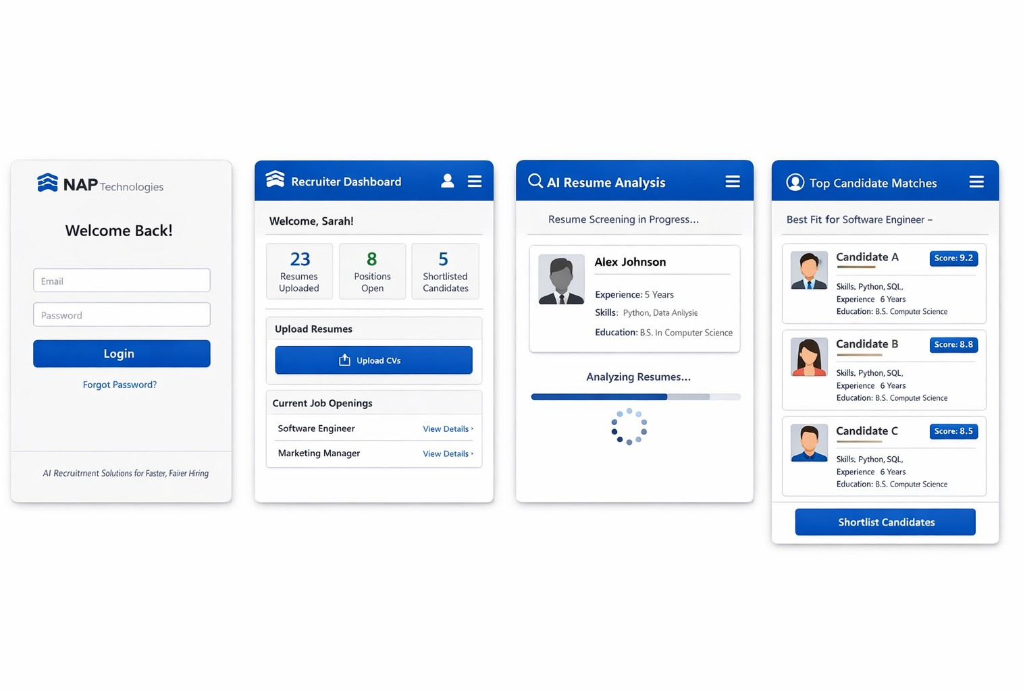
Prototype
Prototype Format
Digital prototype built in Figma with interactive recruitment workflow screens.
Functionality included in the Prototype
Login, recruiter dashboard, resume upload, AI screening simulation, candidate ranking.
{Upload another picture}
Functionality NOT included in the Prototype
Real AI model, ATS integrations, analytics, interview scheduling, payments.

Slide 20
Revenue Models / Pricing
Revenue Model (Primary)
Subscription Model
Revenue Model (Secondary)
Licensing Model

Slide 21



Lean Canvas
 | Solution AI-powered recruitment software that automates resume validation and filtration using natural language processing. It prioritizes applicants based on their skills, experience, and job fit. |  |  | Unfair Advantage | Customer Segment Recruiters and HR managers in mid to large companies facing hiring inefficiencies and bias.,Small & medium- sized enterprises seeking to improve their recruitment process efficiency.
 |  |  |  | Proprietary AI trained on
Problem Manual resume screening causes delays, bias, and |  | Unique value Proposition Full-cycle AI hiring automation delivering unbiased, faster, and |  | diverse candidate data with 97%+ accuracy, continuous learning, enterprise HR system integrations, and customizable AI scoring models.
inefficiency, |  | cost-effective
hurting job |  | recruitment
seekers,
recruiters,
companies, and fair hiring.
 | Key Metric |  |  | Channels
 | Enterprise customers acquired, |  |  | Direct B2B sales to enterprises,
 | subscription renewal rate, |  |  | HR tech partnerships, B2B
 | average time saved per hire, |  |  | marketplaces, SaaS platform
 | candidate satisfaction score, |  |  | (online), integration
 | customer acquisition cost, and |  |  | partnerships with SAP and
 | revenue growth rate. |  |  | Oracle ATS ecosystems.
Cost Structure |  |  | Revenue Streams
AI development and maintenance, cloud infrastructure, data |  |  | Subscription Model, Licensing Model
security, salaries, marketing, customer support, and continuous
product innovation.

Slide 22
Financials
Revenue Models/Streams
Subscription Model Licensing Model
First Year Projections
Revenues: 320000
Pricing
Operating Profits: -250000
Unit of Sale: Monthly SaaS subscription
Selling price per unit: ₹4,999
per month
9

Slide 23
Revenue Models / Pricing
Revenue Model (Primary)
Subscription Model
Unit of Sale
Monthly SaaS subscription
Sale Price per Unit
₹4,999 per month
Expected units to be sold in Year 1
20 subscriptions
Expected growth in monthly sales
12% monthly growth

Slide 24
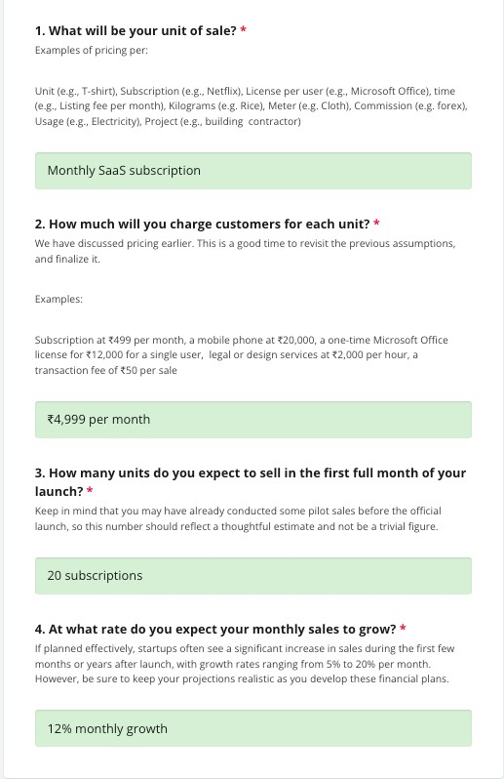
Costs & Revenues: Key Assumptions

Slide 25
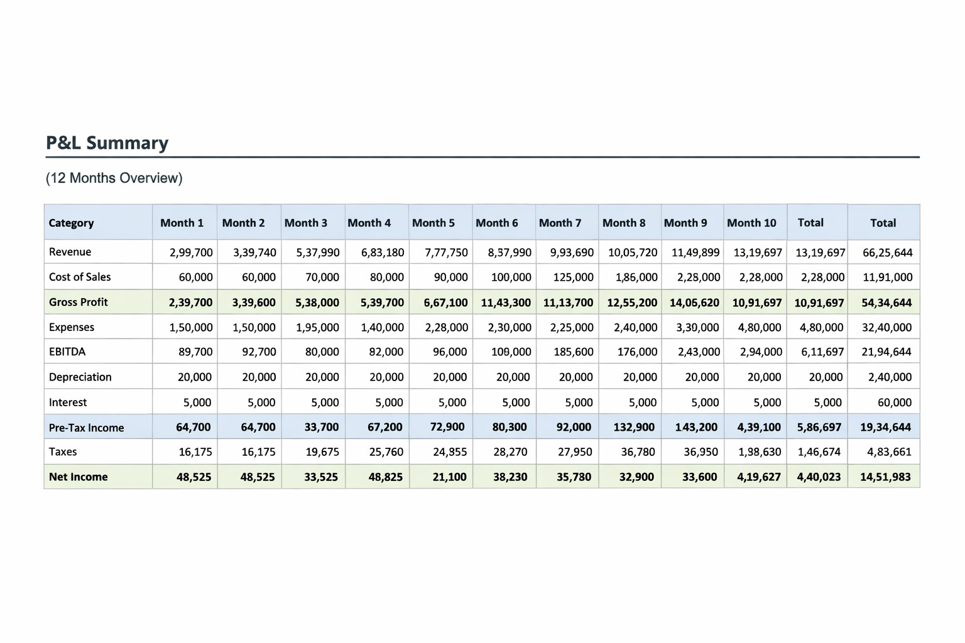
Profit & Loss Projections: Summary

Slide 26
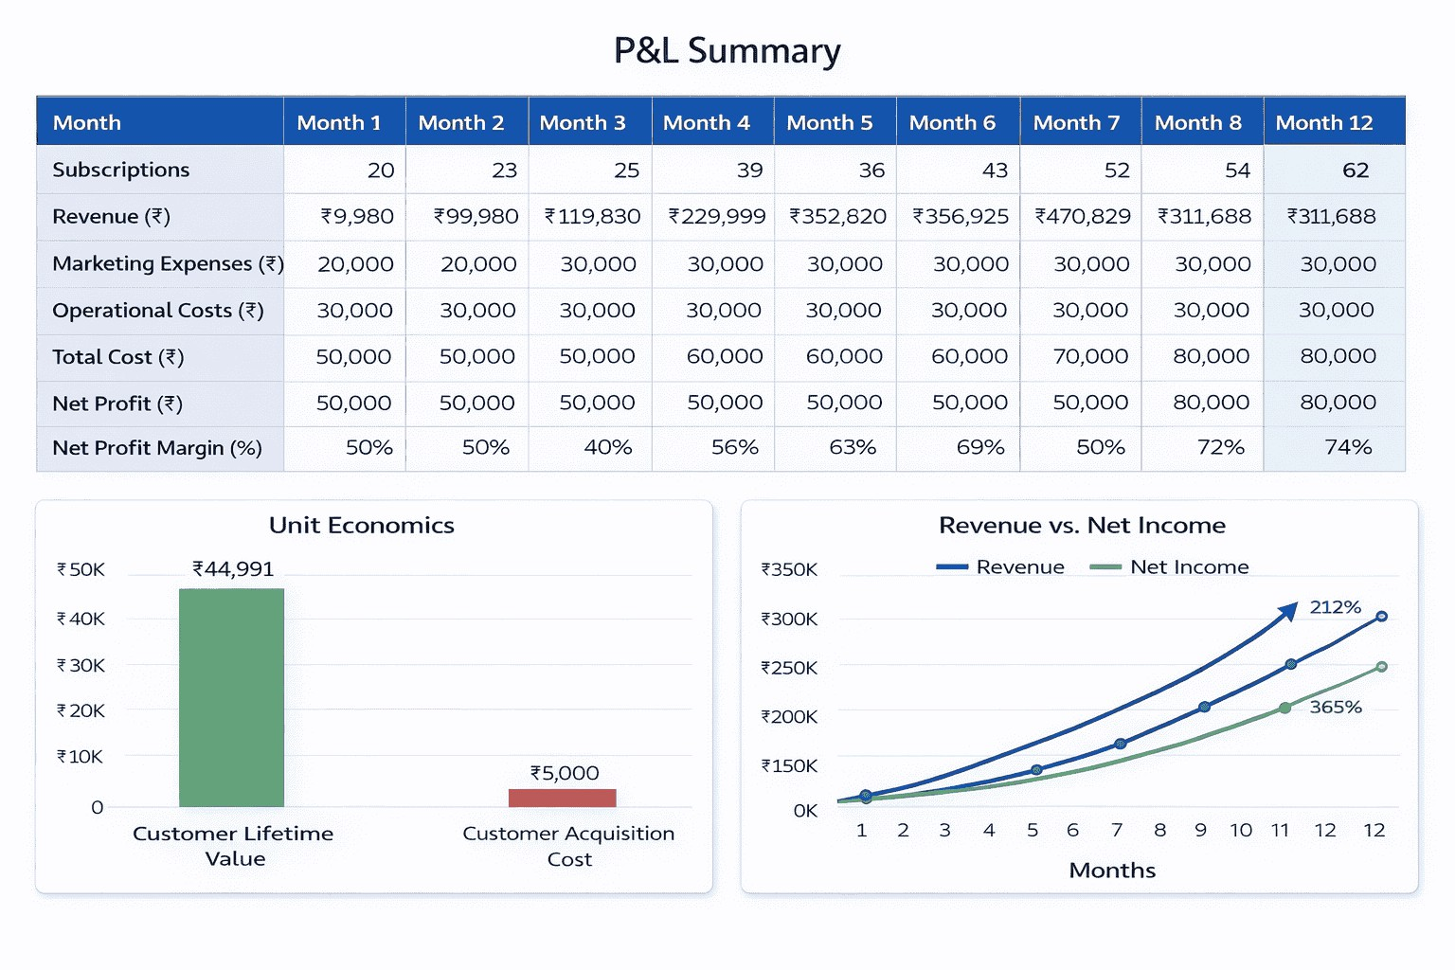
Performance & Break-Even Analysis
Year 1 Revenues 320000 | Gross Profits for Year 1 254000
Net Profits for Year 1 -250000 | Break-even Month 14

Slide 27

Thank You!

